Slide 1
Micro 教程
Notes:
Download more minimal templates here: https://crmrkt.com/GK9Dwa

Slide 2
Hello World
Micro 中国 徐旭
Notes:
Download more minimal templates here: https://crmrkt.com/GK9Dwa

Slide 3
安装
编写第一个服务

Slide 4
依赖
protoc-gen-micro
protoc-gen-go
Micro
go-micro
micro

Slide 7
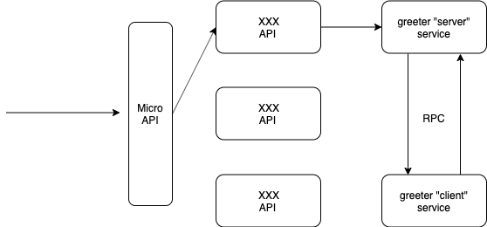

Slide 8
感谢观看
Micro 中国
https://github.com/micro-in-cn
Notes:
Download more minimal templates here: https://crmrkt.com/GK9Dwa

